Slide 1
Individual homework
Semantic Tableux Method exercise 2.2
Prove that the following formula is a tautology using the semantic tableaux method: (p∧q→r)→(p→(q→r))
Danicico George - 912

Slide 2
Theoretical results
A branch of a semantic tableau is called closed (marked by ⦻) if it contains a formula and its negation, otherwise the branch is called open (marked by the symbol ⊙).
A branch of a semantic tableau is called complete if it is closed or all the formulas on that branch are already decomposed.
A propositional formula U is a tautology if and only if ¬U is a closed semantic tableau.
A semantic tableau is called closed if all its branches are closed.

Slide 3
Decomposition rules for propositional formulas
Conjunctive formulas, which are consistent only if both of its component sub-formulas are satisfied, are decomposed using α-rule.
Disjunctive formulas, which are satisfied if one of its component sub-formulas is satisfiable (consistent) are decomposed using β-rules.
A ∧ B
|
A
|
B
¬(A V B) ≡ ¬A ∧ ¬B
|
¬A
|
¬B
¬(A → B) ≡ A ∧ ¬B
|
A
|
¬B
A V B
/ \
A B
¬ (A ˄ B) ≡ ¬ A V ¬B
/ \
¬A ¬B
A → B ≡ ¬A V B
/ \
¬A B

Slide 4
Construction of a semantic tableau
To a propositional formula U we can associate a semantic tableau, which is a binary tree having formulas in its nodes and it is built as follows:
the root of the tree is labeled with the initial formula
every branch of the tree which contains a formula will be extended with a subtree according to the decomposition rule specific to its class
the extension of a branch stops in the following cases:
I) if that branch contains a formula and its negation, the branch is marked as closed using the symbol ⦻ .
II) if all the formulas on that branch are already decomposed or if by decomposing the formulas which are not decomposed yet, no new formulas are obtained.

Slide 5
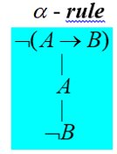
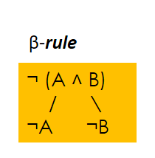
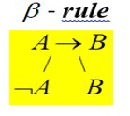
Solution
Prove that the following formula is a tautology using the semantic tableaux method:
Initial formula U = (p∧q→r)→(p→(q→r))
¬U = ¬((p∧q→r)→(p→(q→r))) (1)
α-rule (1)
P∧q→r (2)
¬(p→(q→r)) (3)
α-rule (3)
¬(q->r) (4)
p
α-rule (4)
q
All branches of the semantic tableau are closed, containing pairs of opposite literals: (¬q,q), (¬p,p), (¬r,r). ¬U has no models,thus it is an inconsistent formula => U is a tautology.
¬r
β-rule (2)
¬(P∧q) (5)
r
⦻
β-rule (5)
¬p
¬q
⦻
⦻

Slide 6
Conclusion
I proved that ¬U has no models, it is an inconsistent formula, and we can conclude that the initial formula, U is a tautology.

Slide 7

THANK YOU FOR YOUR ATTENTION!

